Slide 1
Customer Churn - Visualizing Insights, Conclusions, and Recommendations
File created on: 10/25/2024 7:10:10 PM

Slide 2


Slide 3
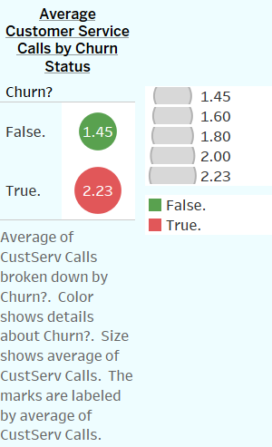

Slide 4
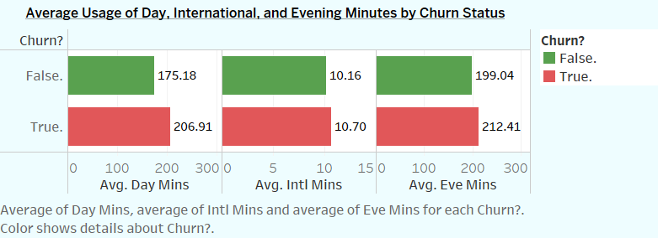

Slide 5
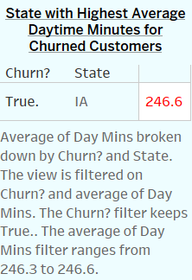

Slide 6
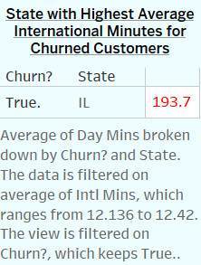

Slide 7
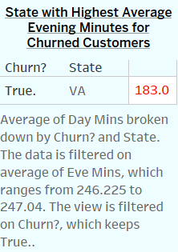

Slide 8


Slide 9
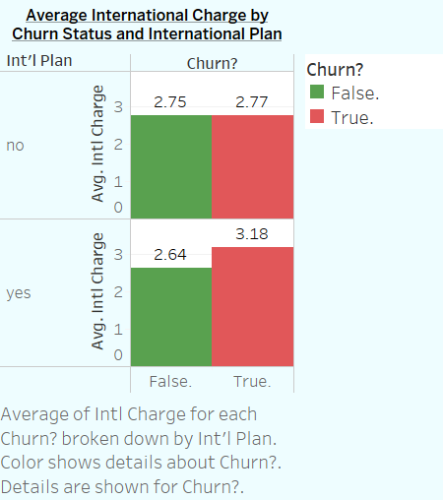

Slide 10
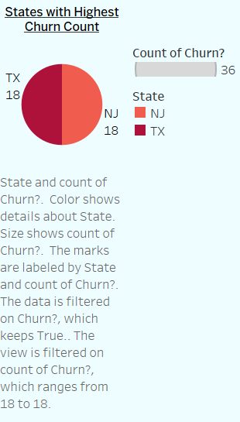

Slide 11
